Slide 1

A case study by Amir Hassanein
7/23/2025

Slide 2
Table of Contents
Problem Statement
Executive Summary
Overview of Analysis
Analysis
Customer Experience Pain Points
My Recommendations
Recommendations Impact
Appendix

Slide 3
Problem Statement
TelCo Inc., a telecommunications company, has noticed that the company’s customer satisfaction (CSAT) scores are low and contact volume is high.
The client is concerned about how the poor experience is impacting their brand perception. The client thinks there are some opportunities to improve the end-to-end customer experience, but they are not sure what their customers pain points are.

Slide 4
Executive Summary
This case study analyzes the root causes behind TelCo Inc.'s low customer satisfaction and high contact volume using both quantitative and qualitative data. The analysis focused on CSAT scores, NPS trends, contact reasons, agent performance, and resolution types.
Key findings reveal that:
82% of repeat contacts result in low CSAT, indicating poor First-Contact Resolution (FCR).
Self-service tools are either ineffective or absent, leading to unnecessary inbound volume.
Tier 1 advisors consistently underperform compared to Tier 2, with a mode CSAT rating of 1 versus 3.
Billing-related queries generate 47 contacts, 87% of which result in dissatisfaction.
Based on these insights, four strategic recommendations were proposed to improve customer experience and reduce operating costs:
Improve First-Contact Resolution (FCR) by empowering Tier 1 advisors.
Optimize and expand self-service capabilities.
Enhance billing transparency.
Redesign feedback collection and encourage participation.
Estimated Impact:
📉 Reduce unnecessary contacts by over 100 cases.
💸 Save up to $1,000+ in support costs. (Cost per Contact = $7)
📈 Improve CSAT performance by up to 48%.
These initiatives not only elevate customer satisfaction but also enhance operational efficiency and long-term brand perception.

Slide 5
Overview of Analysis
Objective:
To identify the root causes behind low CSAT and high contact volume using quantitative and qualitative techniques.
Approach:
Data Integration: Merged “Customer Survey Results” & “Account Interactions” using Power Query.
Exploratory Data Analysis (EDA): Identified repeat contacts, dissatisfaction trends, agent performance.
Tools Used:
Excel – Pivoting, metrics summary.
Python – Word Cloud generation.
Tableau – Correlation & regression for CSAT vs NPS., and other EDA.
Key Metrics Investigated:
Repeat contact rate vs CSAT.
Advisor Tier vs Satisfaction.
Contact reason & resolution type.
Self-service attempts and outcomes.

Slide 6
Potential drivers of low customer satisfaction and high contact volume
1 – Weak First Contact Resolution (FCR)
Customers with 2 interactions have a low CSAT of 82%, compared to 34% for one-time contacts.
This indicates that most issues are not resolved in the first interaction which leads to customers’ frustration.
2- Potential Policy Conflict
The calls received with contact reasons “Service Question”, “Add Services”, and “Change Plan” achieved 100%, 90%, and 83% Low CSAT rate respectively.
These calls must have triggered conflict between the customer’s interest and the company policy.
Low = 1, 2, 3 Customer Satisfaction Rate
High = 4, 5 Customer Satisfaction Rate

Slide 7
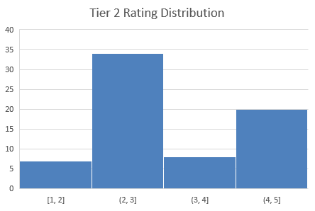
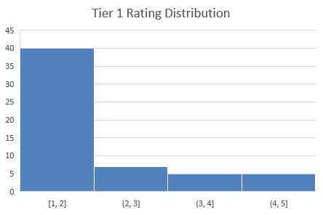
Potential drivers of low customer satisfaction and high contact volume
3 – Low Agent Tier Performance
The right skewed distribution of Tier 1 advisors suggest that the experience of the advisor plays a vital role in handling the customers’ issues.
Most of the interactions with Tier 1 advisors lie in the bucket 1:2 while Tier 2 advisors usually achieve 3:5 as seen from the dual peaks in the Histogram on the right.
The Summary Statistics also confirm this with a Mode rating of 3 for Tier 2 and only 1 for Tier 1. The ratings of Tier 2 advisors are also more consistent as seen from the slightly lower standard deviation.

Slide 8
Potential drivers of low customer satisfaction and high contact volume
4 – Self-Service: Attempted ≠ Resolved
Users who tried App or Web-based self-service still had High dissatisfaction (71–88%)
Even those who didn't attempt were at 69% Low CSAT, indicating lack of viable self-service paths.
Self-service is either ineffective or not aligned with resolution goals.
5 – Ineffective Resolutions
Action | Interactions | Low CSAT Count | CAST %
Disconnect | 13 | 13 | 100%
Provide Info | 11 | 11 | 100%
Transfer | 18 | 18 | 100%
Explain Bill | 6 | 5 | 83%
Add Device | 10 | 8 | 80%
Add Data | 13 | 10 | 77%
Change Plan | 4 | 3 | 75%
Cancel Service | 3 | 2 | 67%
Refund Account | 39 | 25 | 64%
Activate Device | 7 | 1 | 14%
Process Payment | 19 | 2 | 11%
Customers receiving "Transfer", "Provide Info", or "Explain Bill" as resolution reported 100%, 100%, and 83% dissatisfaction respectively.
Resolution outcomes often feel like deflections, not solutions.
Tier 1 advisors are responsible for 100% of the Transfers, and all of them scored 3 or less in the Customer Satisfaction rate.

Slide 9

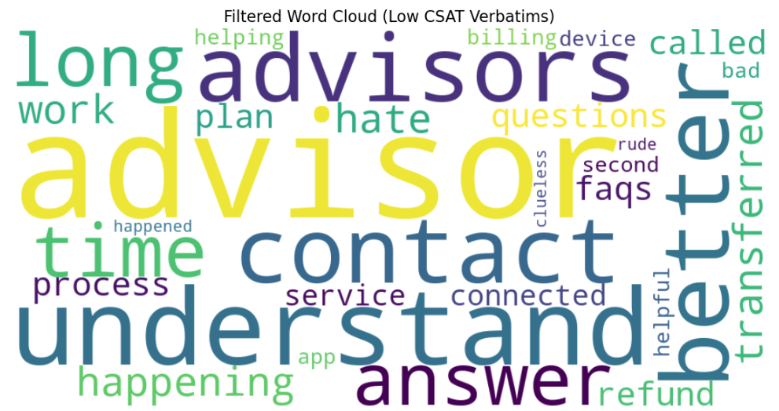
Potential drivers of low customer satisfaction and high contact volume
BONUS
I created a Word Cloud using Python based on the Verbatims column to see what were the most common “words” in the customers’ comments.
The result I ended up with confirms the above factors related to the advisors, the customers being unaware & dissatisfied about the policies, billing issues, unpleasant transfers, and refund issues.
Notes:
Python Script

Slide 10
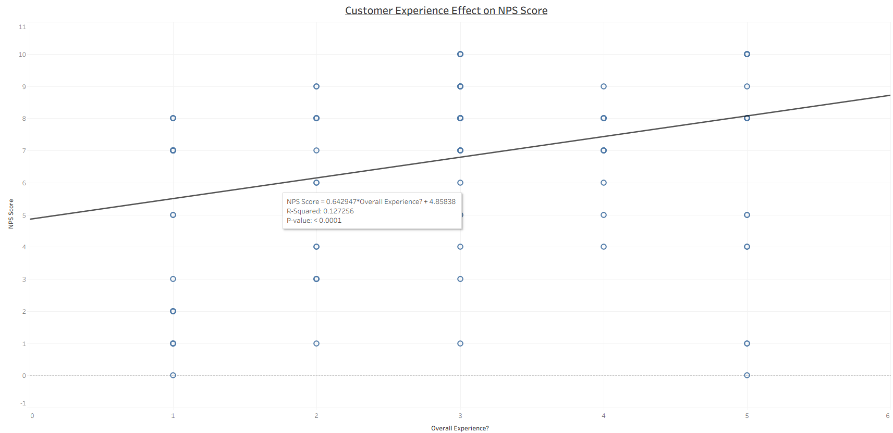
How does the overall customer experience impact brand perception?
I wanted to assess whether the low CSAT affects the customers’ willingness to recommend the brand which is a logical indicator of the brand perception, so I looked at the relationship between The NPS Score and The Overall Customer Experience using Tableau:
The regression analysis shows a Statistically significant positive relationship between the Overall Experience and the NPS Score. However, with an R² of only 0.127, the strength of this relationship is relatively weak.
This suggests that the Overall Experience score effect on the customers’ recommendation of the brand is unexpectedly weak.
Other factors such as Pricing, Support Quality, and Product Reliability might be strong factors. Therefore, additional features are needed to better understand the full picture of Brand Perception.
Notes:
Tableau: Regression Analysis_CASE Study

Slide 11
Customer Experience Pain Points
The customers’ pain points can be summarized in the below points based on the conducted analysis shown in the prior slides:
Unresolved service inquiries – Customers report submitting questions that go unanswered or unresolved.
Ineffective self-service tools – Attempts to resolve issues via automated channels often fail, increasing frustration.
Billing-related concerns – Disputes and confusion regarding charges, leading to distrust.
Repeated contact attempts – Customers are forced to reach out multiple times which reduces the customer experience score significantly.
Ineffective Resolutions – Customers receiving "Transfer", "Provide Info", or "Explain Bill" as resolution reported 100%, 100%, and 83% dissatisfaction respectively.
Low effectiveness of Tier 1 agents – First-line support is often unable to solve problems, causing escalation delays.

Slide 12
My Recommendations
Implement First-Contact Resolution (FCR) - Empower agents with tools and training to resolve issues without escalation.
Revamp Self-Service Channels - Optimize FAQs, chatbots, and portals based on real customer journey data.
Billing Transparency - Simplify invoices and make billing policies easier to access and understand.
Tiered Support Structure Enhancement - Improve Tier 1 training and set clear escalation protocols.
Customer Feedback Loop - Create short post-resolution surveys to identify service gaps and close them continuously. The customers can also be motivated with rewards to get more responses than the current rate of 0.5%

Slide 13
Recommendations Impact
Implementing First-Contact Resolution (FCR)
If the customers didn’t have to contact more than once, the total contacts would have been reduced by 51 which results in $357 in savings.
Another benefit would be increasing the customer experience score by 48% assuming we achieved 34% low CSAT instead of 82%.
2. Designing Effective Self-Service Tools
If the customers who tried to use the self-service tools got what they need, the total number of contacts would have been reduced by 58 which results in $406 in savings.
We have also received 18 contacts due to the lack of applicable self-service tools. If those tools exist, we would save $126.
3. Well Trained Advisors
If we can improve the performance of Tier 1 advisors, we would get a most frequent rating (Mode) of 3 in the customer experience score instead of 1 which would increase the overall customer experience score.
The number of Transfers would also decrease because all of the transfers were from Tier 1 advisors. Eliminating the 18 transfers we got from Tier 1 advisors would reduce the cost by $126.
Notes:
Contact Cost is $7 as per the Supplementary Information sheet in the provided workbook***
Tableau: Advisor Tier Effect on Contacts Volume

Slide 14
Recommendations Impact
4. Billing Transparency
47 contacts were received due to Billing Disputes and Questions. 87% of those contacts scored 3 or less in the CSAT. Therefore, having clear and transparent billing policy would reduce the contacts and increase the CSAT.
5. Customer Feedback
Designing more targeted surveys would improve the analysis accuracy and depth to tackle the issues the customers are facing which results in an improved operational effectiveness.
Offering small incentives to the customers who complete the surveys would increase participation rates, providing richer and more representative feedback. This helps uncover business issues and improvement opportunities with greater confidence.

Slide 15
Appendix

Slide 16
Analysis Steps & Strategy
I used the provided workbook Dataset to conduct the analysis in this presentation, and the final recommendations.
No data cleaning was required as the provided sample was already clean.
I started with Exploratory Data Analysis (EDA) on each sheet but I ended up merging the sheets “Customer Survey Results” and “Account Interactions” into one sheet called “Merged” using PowerQuery to have all the features in a single sheet for easier access in the pivot analysis.
I used the “PV_Merged” to create the pivot tables I needed to answer the analysis questions in the “EDA_Merged” sheet.
The “EDA_Merged” sheet acts as the main playground in which I added all the pivot table results and charts with a designated area for each question.
Used Python to create the Word Cloud, and the “Low CSAT” sheet acts as the Data Source for the Python script.
Used Tableau to create more professional visualizations, and to dig deeper into some areas because it’s much faster than Excel.

